Slide 1
CLUSTERING ALGORITHMS
AFFINITY PROPOGATION
MEAN SHIFT
SPECTRAL CLUSTERING
DB SCAN CLUSTERING
OPTICS CLUSTERING
BIRCH CLUSTERING

Slide 2
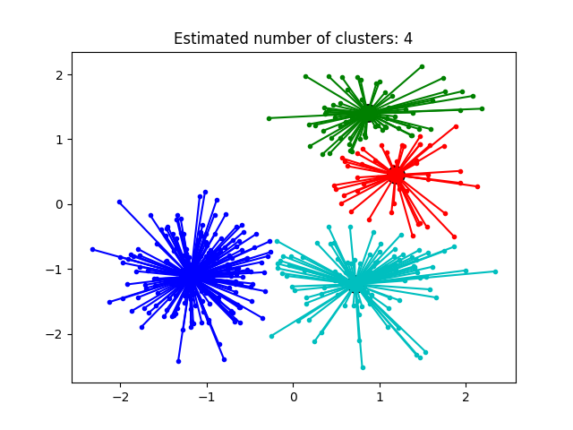
1.AFFINITY PROPOGATION CLUSTERING
Affinity Propagation clustering is a method that autonomously determines the number of clusters without prior specification.
Does not require assumptions about cluster shape or the number of clusters as input.
It operates by iteratively exchanging 'responsibility' and 'availability' messages between data points to efficiently identify exemplars(excellent model) and form clusters around them.

Slide 3
aff=AffinityPropagation(random_state=5)
serves to control the randomness involved in the model's initialization. Setting a specific random state ensures reproducibility of results, making the clustering process deterministic when the same random state is set.
The advantages of using Affinity Propagation clustering.
Autonomous Determination of Clusters: Affinity Propagation autonomously determines the number of clusters without requiring the user to specify it beforehand, unlike algorithms like K-Means that need the number of clusters as input.

Slide 4
Stability Over Runs: Affinity Propagation exhibits better stability over multiple runs compared to some other algorithms, providing consistent results across different executions
Elimination of Specifying Number of Clusters: Unlike traditional clustering algorithms that require the number of clusters to be predefined, Affinity Propagation eliminates this need, making it more flexible and user-friendly.
Stability Over Runs: Affinity Propagation exhibits better stability over multiple runs compared to some other algorithms, providing consistent results across different executions.

Slide 6
2.Mean Shift Algorithm
It is a density-based clustering method that focuses on finding the regions of high density and iteratively shifting data points towards the highest density of points, hence the name “mean-shift.”
The algorithm does not require any prior information about the number of clusters present in the data, making it particularly useful for exploratory data analysis.

Slide 7
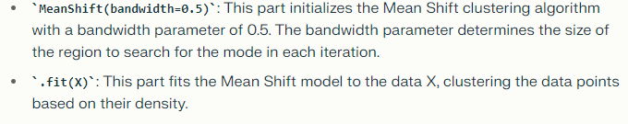
MS=MeanShift(bandwidth=0.5).fit(X)

Slide 8
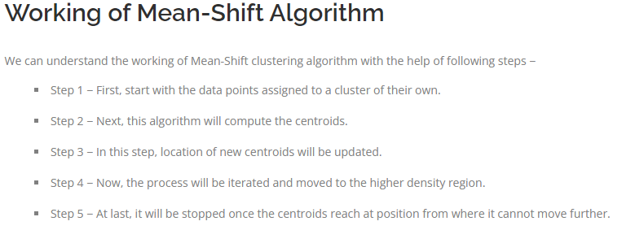

Slide 9
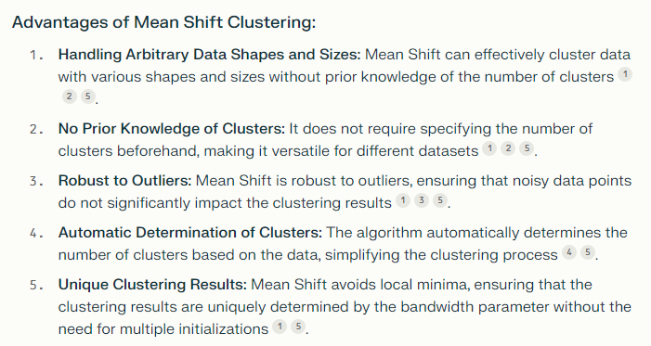

Slide 10
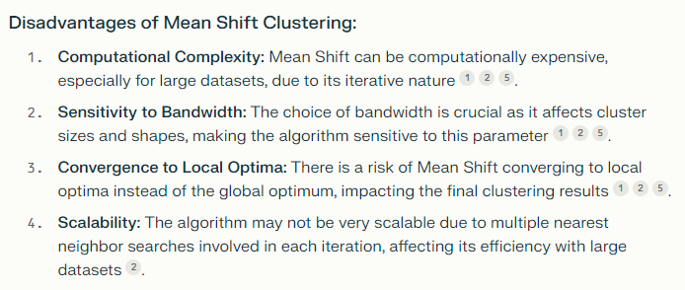

Slide 11
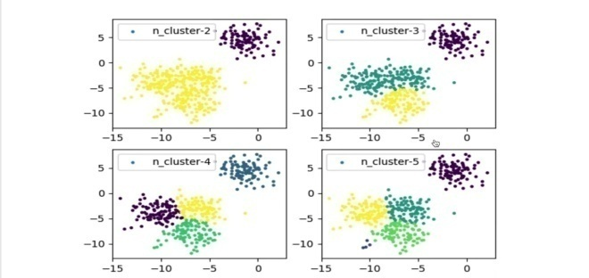
3.SPECTRAL CLUSTERING
Spectral clustering is a powerful unsupervised machine learning algorithm that leverages graph theory and linear algebra to group data points into clusters based on their similarities.
Its looking for nodes in a graph with a small distance between them.
Unlike traditional clustering methods like K-Means, spectral clustering can identify non-convex and irregularly shaped clusters, making it suitable for complex datasets.

Slide 12
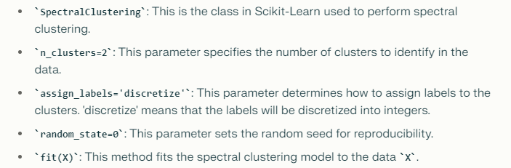
SC=SpectralClustering(n_clusters=2, assign_labels='discretize', random_state=0).fit(X)

Slide 13
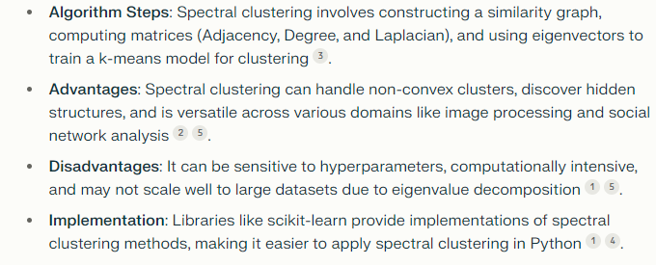
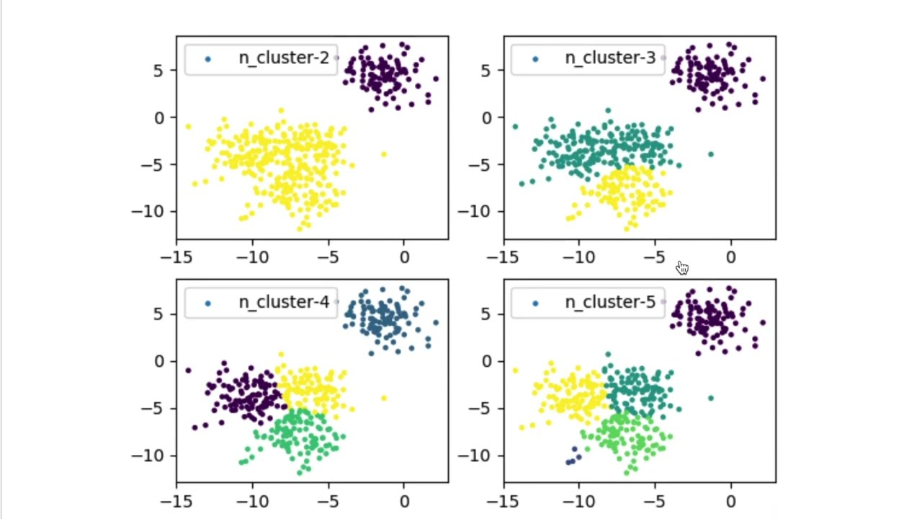

Slide 14
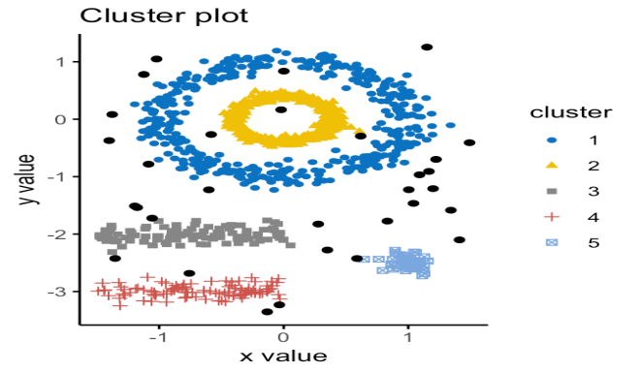
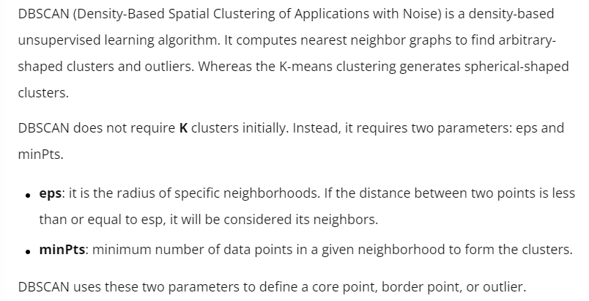
4. DB SCAN CLUSTERING
DB=DBSCAN(eps=3,min_samples=2).fit(X)

Slide 15
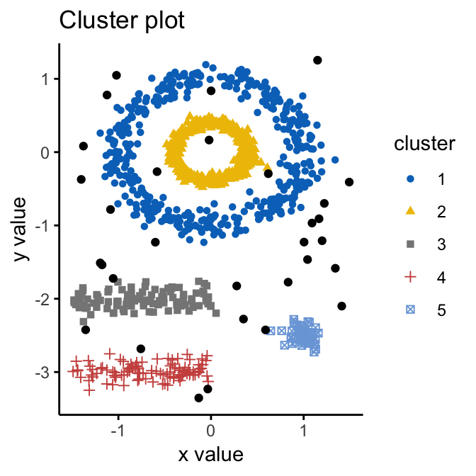
DBSCAN is one of the many algorithms that is used for customer segmentation. You can use K-means or Hierarchical clustering to get even better results. The clustering algorithms are generally used for recommendation engines, market and customer segmentation, social network Analysis, and document analysis.

Slide 16
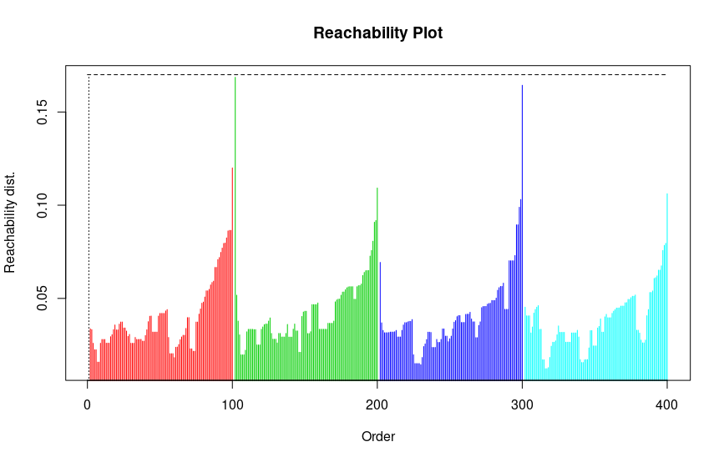
5.OPTICS CLUSTERING
OPTICS (Ordering Points To Identify the Clustering Structure) is a density-based clustering algorithm that is used to identify the structure of clusters in data. It is an improvement over the DBSCAN algorithm, as it can find clusters of varying density, which DBSCAN struggles with due to a fixed "eps" parameter.
OPTICS is particularly useful for datasets where clusters have varying densities and sizes. The algorithm works by ordering points based on their reachability distance, allowing for the identification of clusters at multiple levels of density.

Slide 17
OP=OPTICS(min_samples=2).fit(X)
The min_samples parameter controls the minimum number of samples required to form a dense region, the xi parameter controls the maximum distance between two samples to be considered as a neighborhood, and the min_cluster_size parameter controls the minimum size of a dense region to be considered as a cluster

Slide 18
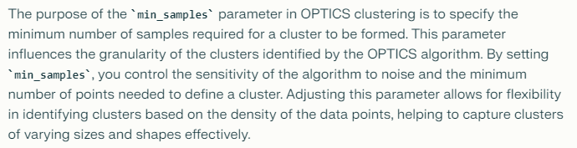

Slide 19
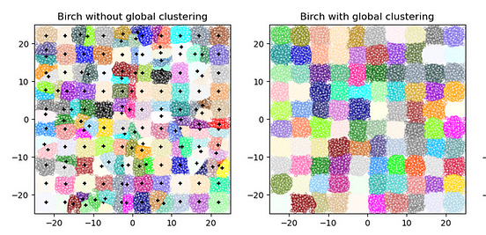
6.BIRCH CLUSTERING
BIRCH (Balanced Iterative Reducing and Clustering using Hierarchies) is a clustering algorithm used for large datasets.
By first generating a small and compact summary of the large dataset that retains as much information as possible. This smaller summary is then clustered instead of clustering the larger dataset.
It converts data to a tree data structure with the centroids being read off the leaf. And these centroids can be the final cluster centroid or the input for other cluster algorithms like AgglomerativeClustering.

Slide 20
BIRCH is a scalable clustering method based on hierarchy clustering and only requires a one-time scan of the dataset, making it fast for working with large datasets. This algorithm is based on the CF (clustering features) tree. In addition, this algorithm uses a tree-structured summary to create clusters. The tree structure of the given data is built by the BIRCH algorithm called the Clustering feature tree(CF tree)

Slide 21
The BIRCH algorithm has several advantages, including scalability, memory efficiency, and fast clustering, but it also has disadvantages, such as sensitivity to parameter settings and limited ability to handle non-spherical clusters and non-Euclidean distance metrics.
The tree cluster of data points as CF is represented by three numbers (N, LS, SS).
N = Number of items in subclusters
LS = vector sum of the data points
SS = Sum of the squared data points
In the image below, we can easily understand the numbers.
brc=Birch(n_clusters=None)

Slide 22
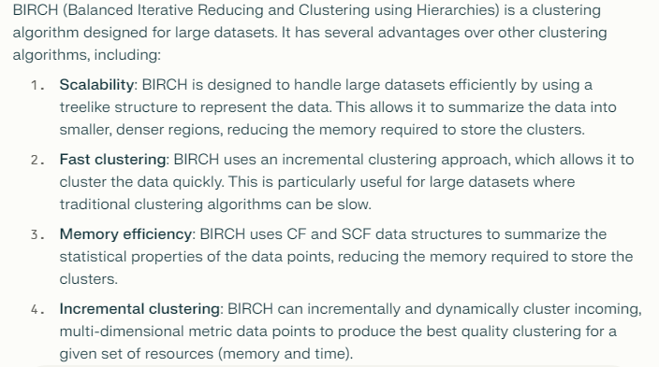
There are three parameters in the BIRCH algorithm.
Threshold – The maximum number of data samples to be considered in a subcluster of the leaf node in a CF tree.
Branching_factor – It is the factor that is used to specify the number of CF sub-clusters that can be made in a node.
N_clusters – number of clusters.

Slide 23
